Slide 1
European Air Pollution Analysis
Carlos Isaac Rodriguez Prado
Hans-Peter Höllwirth
Veronika Kyuchukova

Slide 3
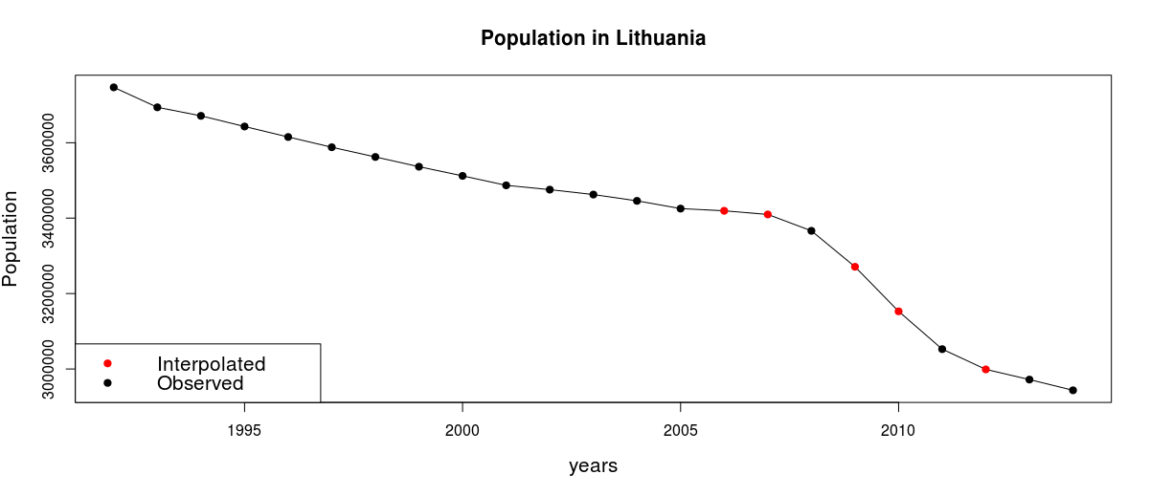
Spline interpolation of population data

Slide 4
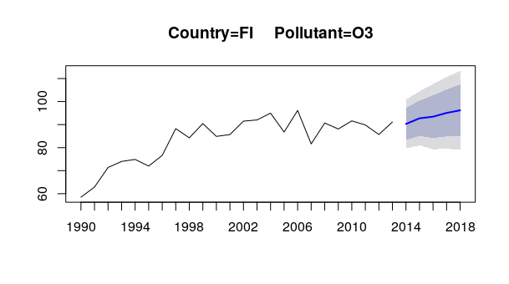
Forecasting future pollutant concentrations

Slide 5









Dashboard architecture
Client (browser)
DB result
DB query
Server

Slide 6
Q & A

